Slide 1
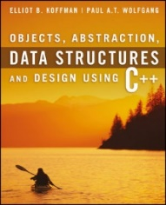
Welcome to
CS 235 Data Structures
Recursion, 7.3-4 (24)

Slide 2
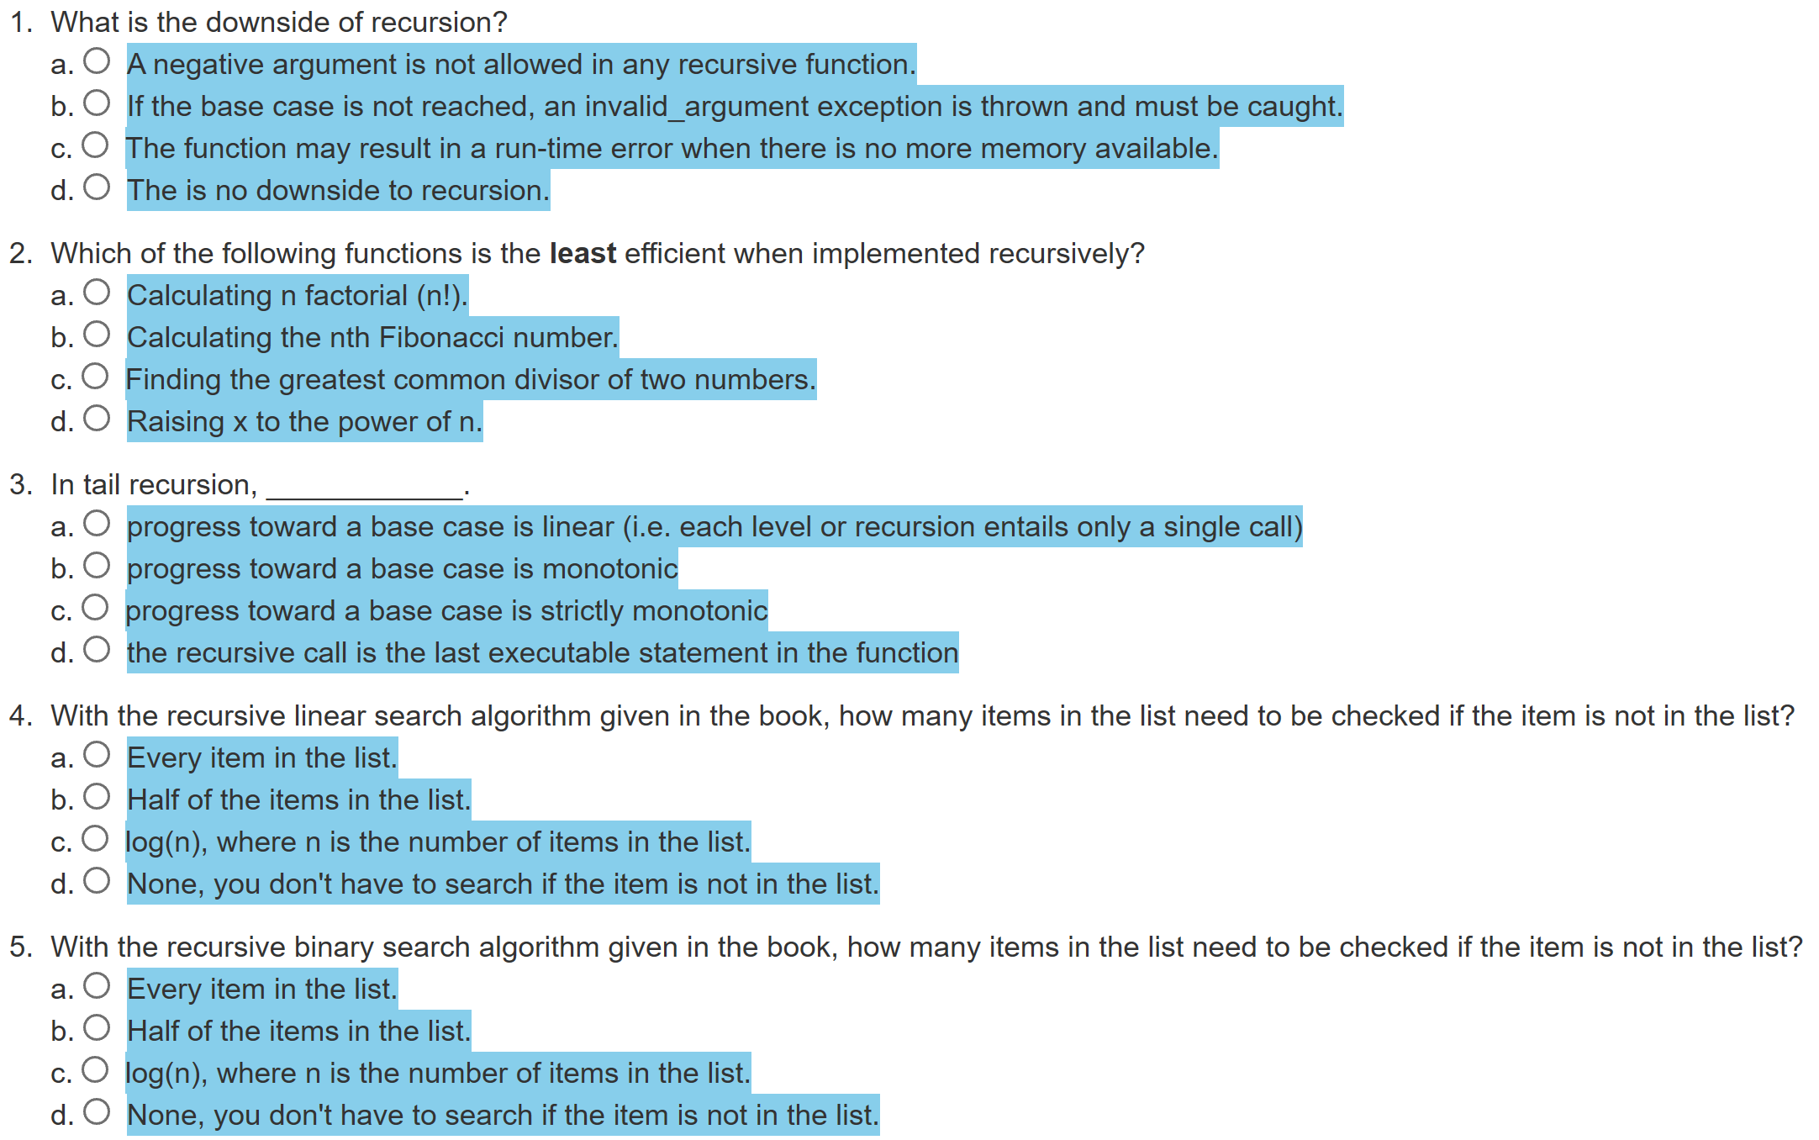
Attendance Quiz #23

Slide 3
Tip #24: Protected - Good Practice?
Encapsulation is one of the main features of OO.
Encapsulating your data in classes means that users of the class can not break the class' data's invariants, because the class' state can only be manipulated through its member functions.
If you allow derived classes access' that invalidate their base class' data invariants, then one essentially throws encapsulation out of the window.
Experienced programmers find themselves using protected less and less over the years, even for member functions.
If a class correctly implements a simple concept, then all of its state should be manipulatable through its public interface.
If derived classes need "back doors" to sneak in, then you should question your design. (Which isn't to say never use protected.)
Remember, protected things in a class only create a contract with direct descendants, and those descendants can decide whether or not to make a similar contract available to sub-descendants.

Slide 4
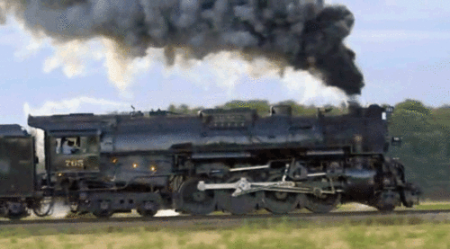
Lab 06 – Railroad

Slide 5
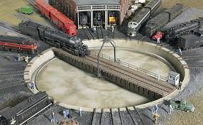
Lab 06 - Railroad
Create a railroad train station that uses a central turntable and roundhouses to store train cars as well as changes the order of cars entering and leaving the station.
Cars may enter the train station if the turntable is empty.
From the turntable cars can be moved to a "stack" roundhouse facility (LIFO) or a "queue" roundhouse facility (FIFO).
Train cars leave the train station by moving from the turntable to a "vector" of outbound cars.
Station 235
What objects (classes)?
Cars
Station
Stack, Queue, Vector
How to describe interactions?
UML
Stack
Queue
Vector
Incoming Cars
Outgoing Cars

Slide 6
Car
Vector<T>
<<interface>>
DequeInterface<T>
-id_:unsigned int
-container__:Deque<T>
+Car()
+Car(const unsigned int&)
+~Car()
+operator==(const Car&):bool
+operator!=(const Car&):bool
+toString() const:string
+Vector()
+~Vector()
+push_back(const T&):void
+pop_back():void
+back():T&
+size():size_t
+at(size_t):T&
+toString() const:string
+static const size_t
DEFAULT_CAPACITY = 4
+DequeInterface()
+~DequeInterface()
+push_front(const T&):void
+push_back(const T&):void
+pop_front():void
+pop_back():void
+front():T&
+back():T&
+size():size_t
+empty() const:bool
+at(size_t):T&
+toString() const:string
Station<T>
-train_:Vector<T>
-stack_:Stack<T>
-queue_:Queue<T>
-turnTableCar_:T
-empty:bool
Queue<T>
-container__:Deque<T>
+Queue()
+~Queue()
+push(const T&):void
+pop():void
+top():T&
+size():size_t
+at(size_t):T&
+toString() const:string
+Station()
+~Station()
+addCar(const T&):string
+removeCar():string
+topCar():string
+sizeTrain():string
+addStack():string
+removeStack():string
+topStack():string
+sizeStack():string
+addQueue():string
+removeQueue():string
+topQueue():string
+sizeQueue():string
+find(T):string
+toString() const:string
Deque<T>
-capacity:size_t
-num_items:size_t
-front_index:size_t
-rear_index:size_t
-the_data:T*
+Deque()
+~Deque()
+push_front(const T&):void
+push_back(const T&):void
+pop_front():void
+pop_back():void
+front():T&
+back():T&
+size():size_t
+empty() const:bool
+at(size_t):T&
+toString() const:string
-reallocate():void
Stack<T>
-container__:Deque<T>
+Stack()
+~Stack()
+push(const T&):void
+pop():void
+top():T&
+size():size_t
+at(size_t):T&
+toString() const:string

Slide 7
deque<string>
capacity
num_items
front_index
rear_index
the_data
#define DEFAULT_CAPACITY 4
template<typename T>
class Deque
{
private:
size_t capacity;
size_t num_items;
size_t front_index;
size_t rear_index;
T* the_data;
4
0
0
3
front_index
0
1
2
3
Deque(void) :
capacity(DEFAULT_CAPACITY),
num_items(0),
front_index(0),
rear_index(DEFAULT_CAPACITY - 1),
the_data(new T[DEFAULT_CAPACITY]) {}
rear_index
circular array
(strings)
/** Return a reference to an item in the deque. */
T& operator[](size_t index)
{
return the_data[(index + front_index) % capacity];
}

Slide 8
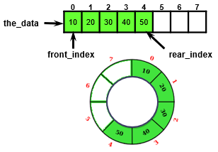
Circular Array ADT Deque Design
A Circular Array ADT Deque uses an object with four size_t type data members:
size_t capacity;
size_t num_items;
size_t front_index;
size_t rear_index;
And a pointer to the data member, the_data to point to a dynamically-allocated array
T* the_data;
And a default array allocation size
#define DEFAULT_CAPACITY 8

Slide 9
deque<string>
capacity
num_items
front_index
rear_index
the_data
#define DEFAULT_CAPACITY 4
template<typename T>
class Deque
{
private:
size_t capacity;
size_t num_items;
size_t front_index;
size_t rear_index;
T* the_data;
4
0
0
3
front_index
0
1
2
3
Deque(void) :
capacity(DEFAULT_CAPACITY),
num_items(0),
front_index(0),
rear_index(DEFAULT_CAPACITY - 1),
the_data(new T[DEFAULT_CAPACITY]) {}
rear_index
circular array
(strings)

Slide 10
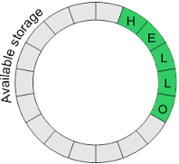
Deque Dynamic Circular Buffer
capacity = 16
num_items = 5
the_data
L | O |  |  |  |  |  |  |  |  |  |  |  | H | E | L
rear_index
front_index
/** Return a reference to an item in the deque. */
T& operator[](size_t index)
{
return the_data[(index + front_index) % capacity];
}
front_index
the_data
rear_index

Slide 11
Dynamic Circular Buffer
front
capacity = 16
num_items = 5
the_data
L | O |  |  |  |  |  |  |  |  |  |  |  | H | E | L
the_data
back
back
front
The modulo operator (%) is a remainder operator with truncated division (towards 0).
If either operand is negative (signed), the remainder operator result has the same sign as the dividend (the first operand in the expression).
When using unsigned operands (size_t), incrementing indexes with wraparound is correctly implemented by:
front = (front + 1) % capacity;
However, decrementing indexes (and capacity is not a power of 2), must use the following :
if (front == 0) front = capacity - 1;
else front = (front - 1) % capacity;

Slide 12
Specification of the Deque
Behavior | Member Function
Insert element at back | void push_back(item)
Insert element at front | void push_front(item)
Remove last element | void pop_back();
Remove first element | void pop_front();
Examine last element | item& back();
Examine first element | item& front();
Index | item& at(index);
Size | size_t size();
*Insert element | iterator insert(iterator, item);
*Remove all items | void remove(item);
*Index | item& []
*Iterator start | iterator begin();
*Iterator end | iterator end();
*Not Required for Lab 06 Deque

Slide 13
Specification of the Deque
Behavior | Member Function
Insert element at back | void push_back(item)
Insert element at front | void push_front(item)
Remove last element | void pop_back();
Remove first element | void pop_front();
Examine last element | item& back();
Examine first element | item& front();
Index | item& at(index);
Size | size_t size();
*Not Required for Lab 06 Deque
*Insert element | iterator insert(iterator, item);
*Remove all items | void remove(item);
*Index | item& []
*Iterator start | iterator begin();
*Iterator end | iterator end();

Slide 14
Wrapper Class
A wrapper (adapter) class is a class that encapsulates or contains another class and uses its functionality to define (add to) the class' behavior.
#include "Deque.h"
template <typename T>
class Vector
{
private:
Deque<T> vector_;
public:
void push_back(T data)
{
vector_.push_back(data);
}
void pop_back(void)
{
vector_.pop_back();
}
...
};
#include "Deque.h"
template <typename T>
class Queue
{
private:
Deque<T> queue_;
public:
void push(T data)
{
queue_.push_back(data);
}
void pop(void)
{
queue_.pop_front();
}
...
};
#include "Deque.h"
template <typename T>
class Stack
{
private:
Deque<T> stack_;
public:
void push(T data)
{
stack_.push_back(data);
}
void pop(void)
{
stack_.pop_back();
}
...
};

Slide 15
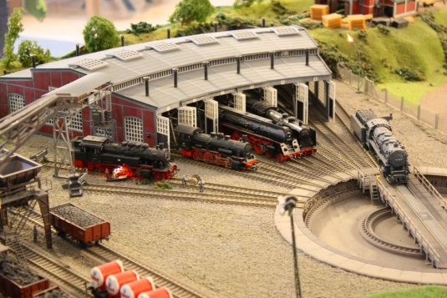
L06 – Railroad Wrapper Classes
Input Commands
Station 235
Station<T>
"Add:station xx"
"Add:stack"
"Add:queue"
"Remove:station"
"Remove:stack"
"Remove:queue"
"Top:station"
"Top:stack"
"Top:queue"
"Size:stack"
"Size:queue"
"Size:train"
"Find xx"
"Queue"
"Stack"
"Train"
string addCar(const T&);
string addStack();
string addQueue();
string removeCar();
string removeStack();
string removeQueue();
string topCar();
string topStack();
string topQueue();
string sizeStack();
string sizeQueue();
string sizeTrain();
string find(T);
string queueToString();
string stackToString();
string vectorToString();
string toString();
Vector<T>, Queue<T>, Stack<T>
void push(const T&);
void pop();
void top();
size_t size();
T& at(size_t);
string toString() const;
<<interface>>
DequeInterface<T>
Deque<T>
void push_front(const T&);
void push_back(const T&);
void pop_front();
void pop_back();
T& front();
T& back();
size_t size();
bool empty() const;
T& at(size_t);
string toString() const;
typedef struct Car car_t;

Slide 16
L06 – Railroad Wrapper Classes
Create a railroad train station that uses a central turntable and roundhouses to store and order train cars. Cars enter the train station if the turntable is empty. From the turntable cars can be moved to a "stack" roundhouse facility (LIFO) or a "queue" roundhouse facility (FIFO). Train cars exit the train station by moving from the turntable to a "vector" of outbound cars.
Station<T>
"Add:station xx"
"Add:stack"
"Add:queue"
"Remove:station"
"Remove:stack"
"Remove:queue"
"Top:station"
"Top:stack"
"Top:queue"
"Size:stack"
"Size:queue"
"Find: xx"
"Train:"
string addCar(const T&);
string addStack();
string addQueue();
string removeCar();
string removeStack();
string removeQueue();
string topCar();
string topStack();
string topQueue();
string sizeStack();
string sizeQueue();
string find(T);
string toString() const;
Vector<T>, Queue<T>, Stack<T>
string push(const T&);
void pop();
void top();
size_t size();
T& at(size_t);
string toString() const;
<<interface>>
DequeInterface<T>
Deque<T>
void push_front(const T&);
void push_back(const T&);
void pop_front();
void pop_back();
T& front();
T& back();
size_t size();
bool empty() const;
T& at(size_t);
string toString() const;

Slide 17
Station Commands
COMMAND | DESCRIPTION | OUTPUT
Add:station <data> Add:queue <data> Add:stack <data> | Train car enters the station turntable. Train car is removed from the turntable and pushed to the Queue roundhouse. Train car is removed from the turntable and pushed to the Stack roundhouse. | OK Turntable occupied! Turntable empty!
Remove:station Remove:queue Remove:stack | A train car is removed from the turntable and pushed into the train vector. A train car is removed from Queue roundhouse and moved to the station turntable. A train car is removed from Stack roundhouse and moved to the station turntable. | OK Turntable empty! Turntable occupied! Queue empty! Stack empty!
Top:station Top:queue Top:stack | Display the current train car on station turntable, Display the train car at head of Queue roundhouse. Display the train car at head of Stack roundhouse. | <data> Turntable empty! Queue empty! Stack empty!
Size:queue Size:stack Size:train | Output number of train cars in Queue/Stack roundhouses and train vector. | Size of Queue/Stack/Train
Find <data> | Find and display the current location and position of a car in the station data structures (turntable, queue, stack, or vector). | Turntable Queue[<index>] Stack[<index>] Train[<index>] Not Found!
Queue Stack Train | Output the contents of the station structures train vector. | List of train cars leaving the station.

Slide 18
Requirements
Points | Requirement (50 Points)
10 | A train car exiting the station turntable is pushed on a train Vector template class that has-a Deque container and operates as described. (lab06_in_01.txt).
10 | The Stack roundhouse consists of a LIFO template class that has-a Deque container and operates as described above (lab06_in_02.txt).
10 | The Queue roundhouse consists of a FIFO template class that has-a Deque container and operates as described above (lab06_in_03.txt).
10 | All the station containers (Queue, Stack, Vector) resize correctly (lab06_in_04.txt).
10 | The Find command finds a train car in the station data structures (queue or stack) or the train vector. If found, the name of the structure and the index within the structure is displayed (as described above.) (lab06_in_05.txt).
-10 | Memory leaks, g++ compiler warnings, array out-of-bounds, or use of STL container detected.
Points | Peer Review
2 | A Deque template class is implemented using a dynamic circular array and is derived from the abstract DequeInterface interface class.
2 | All station facility containers (stack, queue, vector, deque) are separate classes that are implemented by "wrapping" your Deque template class.
2 | The Station, Vector, Queue, Stack, and Deque template classes are instantiated as Car data types.

Slide 19
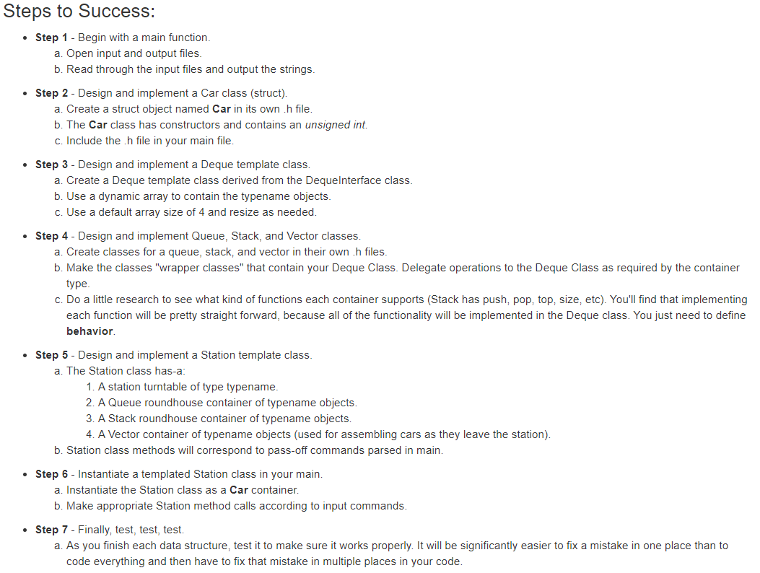

Slide 20
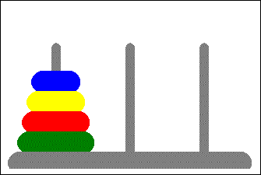
7.4 Problem Solving with Recursion
Case Study: Towers of Hanoi
Case Study: Counting Cells in a Blob
7.4, pgs. 426-434

Slide 21
Towers of Hanoi
Move the three disks to a different peg, maintaining their order (largest disk on bottom, smallest on top, etc.)
Only the top disk on a peg can be moved to another peg.
A larger disk cannot be placed on top of a smaller disk.
L M R
// recursive function to solve Tower of Hanoi puzzle
void move_disk(int disk, char from, char to, char temp)
{
if (disk == 1)
{
cout << "Move disk 1 from " << from << " to " << to << endl;
}
}
move_disk(4, 'L', 'R', 'M')
Move disk 1 from L to M
Move disk 2 from L to R
Move disk 1 from M to R
Move disk 3 from L to M
Move disk 1 from R to L
Move disk 2 from R to M
Move disk 1 from L to M
Move disk 4 from L to R
Move disk 1 from M to R
Move disk 2 from M to L
Move disk 1 from R to L
Move disk 3 from M to R
Move disk 1 from L to M
Move disk 2 from L to R
Move disk 1 from M to R
else
{
// move top disks (disks-1) to temporary peg.
move_disk(disk - 1, from, temp, to);
}
// move bottom disk to destination.
cout << "Move disk " << disk << " from " << from << " to " << to << endl;
// finish by moving temp disks on top of destination.
move_disk(disk - 1, temp, to, from);

Slide 22
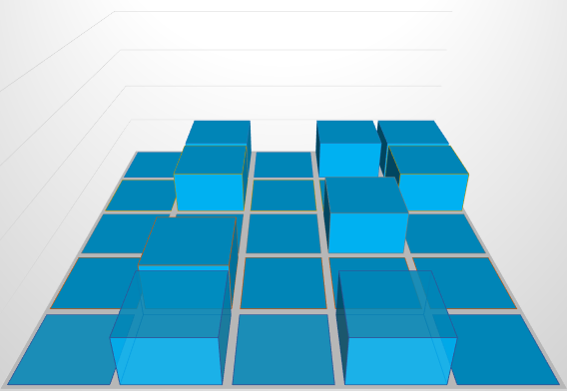
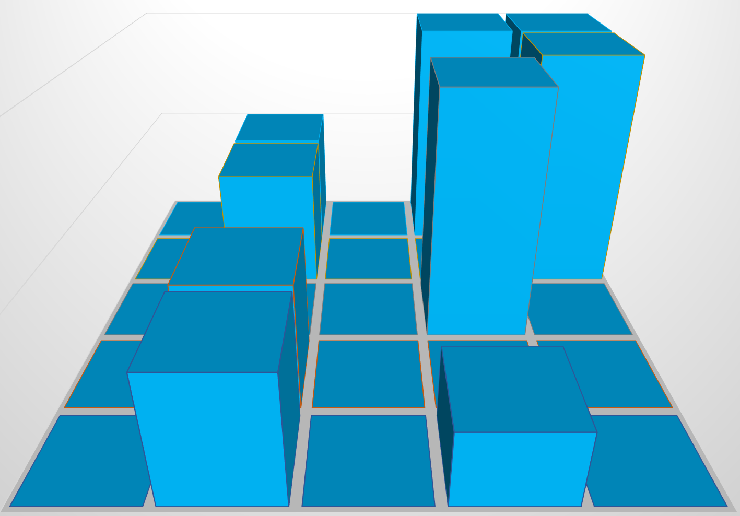
Counting Cells in a Blob
Consider how we might process an image that is presented as a two-dimensional grid of color values.
Information in the image may come from
Medical records (X-ray, MRI, death records, …)
Big data (NSA, Google, Facebook, …)
Satellite imagery
Shopping networks
Problem:
The goal is to determine the size of any area in the image that is considered abnormal because of its color values.
Given a two-dimensional grid of cells, each cell contains either a normal background color or a second color, which indicates the presence of an abnormality.
A blob is a collection of contiguous abnormal cells.
A user will enter the x, y coordinates of a cell in the blob, and the program will determine the count of all cells in that blob.

Slide 23
Count Cells in a Blob
#include <iostream>
using namespace std;
enum color { NORMAL, ABNORMAL, TEMPORARY };
const int ROW_SIZE = 5;
const int COL_SIZE = 5;
int cells(color[ROW_SIZE][COL_SIZE], int, int) { ... }
int main()
{
int row, col;
color grid[ROW_SIZE][COL_SIZE] = {
{ NORMAL, ABNORMAL, NORMAL, ABNORMAL, ABNORMAL },
{ NORMAL, ABNORMAL, NORMAL, NORMAL, ABNORMAL },
{ NORMAL, NORMAL, NORMAL, ABNORMAL, NORMAL},
{ NORMAL, ABNORMAL, NORMAL, NORMAL, NORMAL},
{ NORMAL, ABNORMAL, NORMAL, ABNORMAL, NORMAL} };
// Enter row and column of a cell in the blob
cout << "Enter row: "; std::cin >> row;
cout << "Enter column: "; std::cin >> col;
// Output cells in blob containing grid[row][col]
cout << cells(grid, row, col) << endl;
}

Slide 24
Count Cells in a Blob
/** Count number of blob cells that contains grid[r][c]
pre: Abnormal cells are in ABNORMAL color.
Other cells are in NORMAL color.
post: All cells in the blob are in TEMPORARY color.
@parm r The row of the blob cell
@parm c The column of a blob cell
@return The number of cells in the blob.
*/
int cells(color grid[ROW_SIZE][COL_SIZE], int r, int c)
{
if (r < 0 || r >= ROW_SIZE || c < 0 || c >= COL_SIZE) return 0;
if (grid[r][c] != ABNORMAL) return 0;
}
grid[r][c] = TEMPORARY;
int blob = 1;
blob += cells(grid, r-1, c-1) + cells(grid, r-1, c+0) + cells(grid, r-1, c+1);
blob += cells(grid, r+0, c-1) + cells(grid, r+0, c+1);
blob += cells(grid, r+1, c-1) + cells(grid, r+1, c+0) + cells(grid, r+1, c+1);
return blob;

Slide 25
Test Counting Cells in a Blob
Verify that the code works for the following cases:
A starting cell that is on the edge of the grid
A starting cell that has no neighboring abnormal cells
A starting cell whose only abnormal neighbor cells are diagonally connected to it
A "bull's-eye": a starting cell whose neighbors are all normal but their neighbors are abnormal
A starting cell that is normal
A grid that contains all abnormal cells
A grid that contains all normal cells
•
 |  | •
 |  | •
 |  | •
 |  | •

Slide 27
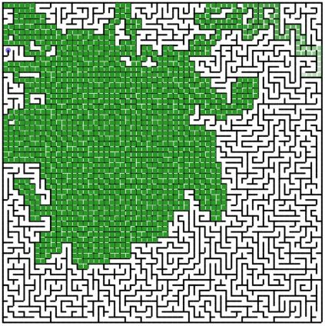
7.5 Backtracking
Case Study: Finding a Path Through a Maze
7.5, pgs. 435-440

Slide 28
Backtracking
Backtracking is an approach to implementing a systematic, non-repetitive, trial and error search for a solution to a maze.
As one encounters a path junction, a path is chosen.
Either you will reach your destination and exit the maze, or you won’t be able to go any farther.
If you can’t go any farther, you will need to consider alternative paths—you will need to backtrack until you reach a fork and follow a branch you did not travel hoping to reach your destination.
If you never try the same path more than once, you will eventually find a solution path if one exists.
Problems that are solved by backtracking can be described as a set of choices made by some function.
Recursion allows you to implement backtracking in a relatively straightforward manner.
Each activation frame is used to remember the choice that was made at that particular decision point.algorithm.

Slide 29
Finding a Path through a Maze
Problem
Use backtracking to find and display the path through a maze
From each point in a maze you can move to the next cell in a horizontal or vertical direction if the cell is not blocked.
Analysis
The maze will consist of an array of cells.
The starting point is at the top left corner maze[0][0].
The exit point is at the bottom right corner, that is
maze[ROW_SIZE - 1][COL_SIZE - 1].
All non-barrier cells will be OPEN color.
All cells that represent barriers will be BARRIER color.
Cells that we have visited will be VISITED color.
If we find a path, all cells on the path will be set to PATH color.

Slide 30
Design find_maze_path(x, y)
Out of Bounds?
Y
N
Open Path?
Visit
Neighbor
N
Return FALSE
Y
Path Found?
Return TRUE
Mark Cell as Path
Y
N
Maze Exit?
More
Neighbors?
Mark Cell as Visited
N
Y
N
Y
Return TRUE
Return FALSE
There is no attempt to find the shortest path through the maze.
We just mark the first path that is found.

Slide 31
Implementation
bool find_path(color maze[HEIGHT][WIDTH], int r, int c)
{
}
if ((r < 0) || (r >= HEIGHT) || (c < 0) || (c >= WIDTH))
return false; // Out of bounds, not path
if (maze[r][c] != OPEN)
return false; // Path blocked, not path
maze[r][c] = PATH; // Assume path
if ((r == HEIGHT - 1) && (c == WIDTH - 1))
return true; // Exit, success!
// Look for path above, left, right, below
if (find_path(maze, r - 1, c + 0)) return true;
if (find_path(maze, r + 0, c - 1)) return true;
if (find_path(maze, r + 0, c + 1)) return true;
if (find_path(maze, r + 1, c + 0)) return true;
maze[r][c] = VISITED; // Not a path, but don’t visit again
return false;

Slide 32
Testing
#include <iostream>
using namespace std;
enum color { OPEN, BARRIER, VISITED, PATH };
const int HEIGHT = 5;
const int WIDTH = 5;
bool find_path(color maze[HEIGHT][WIDTH], int r, int c) { ... }
int main()
{
color maze[HEIGHT][WIDTH] =
{ { OPEN, BARRIER, OPEN, BARRIER, BARRIER },
{ OPEN, BARRIER, OPEN, BARRIER, BARRIER },
{ OPEN, OPEN, OPEN, BARRIER, OPEN },
{ OPEN, BARRIER, OPEN, OPEN, OPEN },
{ OPEN, BARRIER, OPEN, BARRIER, OPEN }
};
cout << boolalpha << find_path(maze, 0, 0) << endl;
return 0;
}
S
 |  |  |  | E
S
 |  |  |  | E

Slide 33
Marking a Cell as Visited
Would the program still work if instead of recoloring a “dead end” to the temporary color, we recolored it to the open color?
The answer is “Yes”. This would not affect the ability of the algorithm to find a path or to determine that none exists; however, it would affect the algorithm’s efficiency:
After backtracking, the function could try to place on the path a cell that had been found to be a dead end.
The cell would be classified once again as a dead end.
Marking it as a dead end (color VISITED) the first time prevents this from happening.
Test for a variety of test cases:
Mazes that can be solved
Mazes that can't be solved
A maze with no barrier cells
A maze with a single barrier cell at the exit point

Slide 34
Be Safe

